Slide 1
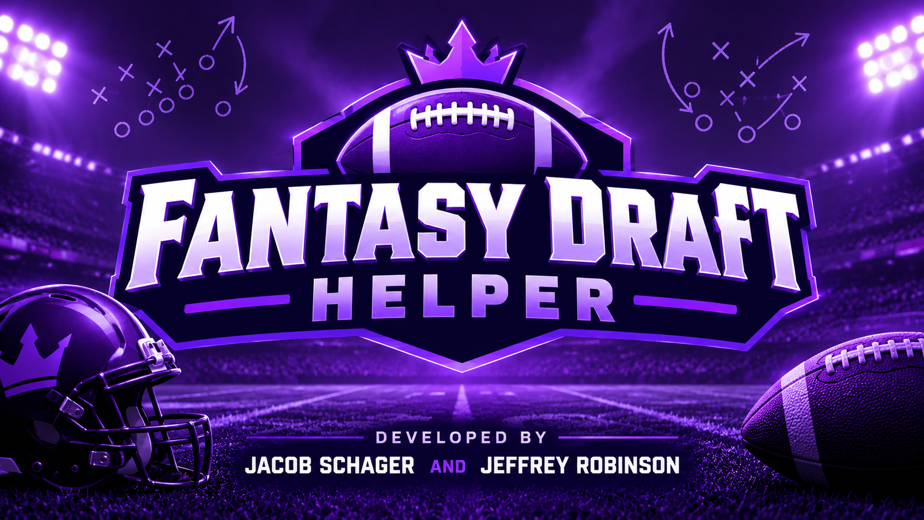

Slide 2
Overview
Our application tracks a Fantasy Football draft in real time and suggests the user’s next pick based on NFL statistics and current player reports.
Most auto draft features are not always reliable because of unbalanced rosters, not keeping up with current trends, and lack of strategic control.
This application assists people who don’t have a lot of football knowledge or those want some additional research alongside strategic control before choosing their players.
The draft information and current player statistics are pulled using Sleeper’s API
The model used to process the information and user prompts is Google’s gemini-3.5-flash-lite model
The GUI interface is implemented using Tkinter.

Slide 3
Development of the Project
We began by setting up a project in Google’s ai studio and getting an API key.
We landed upon using Gemini 3.5 Flash Lite due to its free high tokens per minute and strong thinking capabilities.
Sleeper API is a read-only API which gives league, draft, user, and player information.
Sleeper allows for up to 1,000 requests per minute which allows us to keep our application constantly up to date with the current draft
Claude was used for the development of the front-end interface

Slide 4

The Code
The Sleeper Class is responsible for making direct API calls and filtering the data so that it is readable by the agent and the other classes.
The Gemini class collects the filtered draft information and makes the analysis based on the data and the user’s prompts/draft picks.
The DraftInfo class is primarily used by the interface and determines the logic behind whether the player is ready to draft; it also presents draft information in a concise way for the interface to pull from.
The interface takes input from the user to send to the Gemini class. It also displays the draft information and pick suggestions to the user.

Slide 5
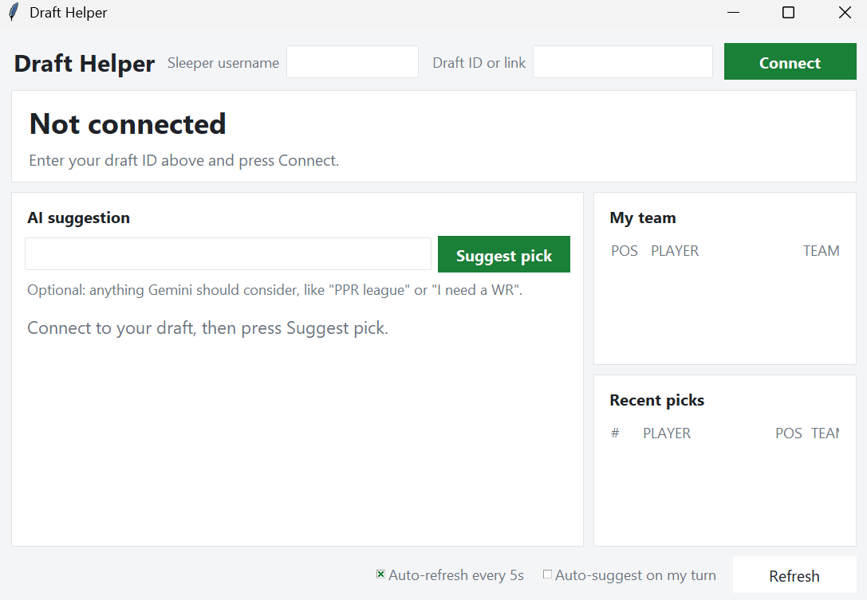
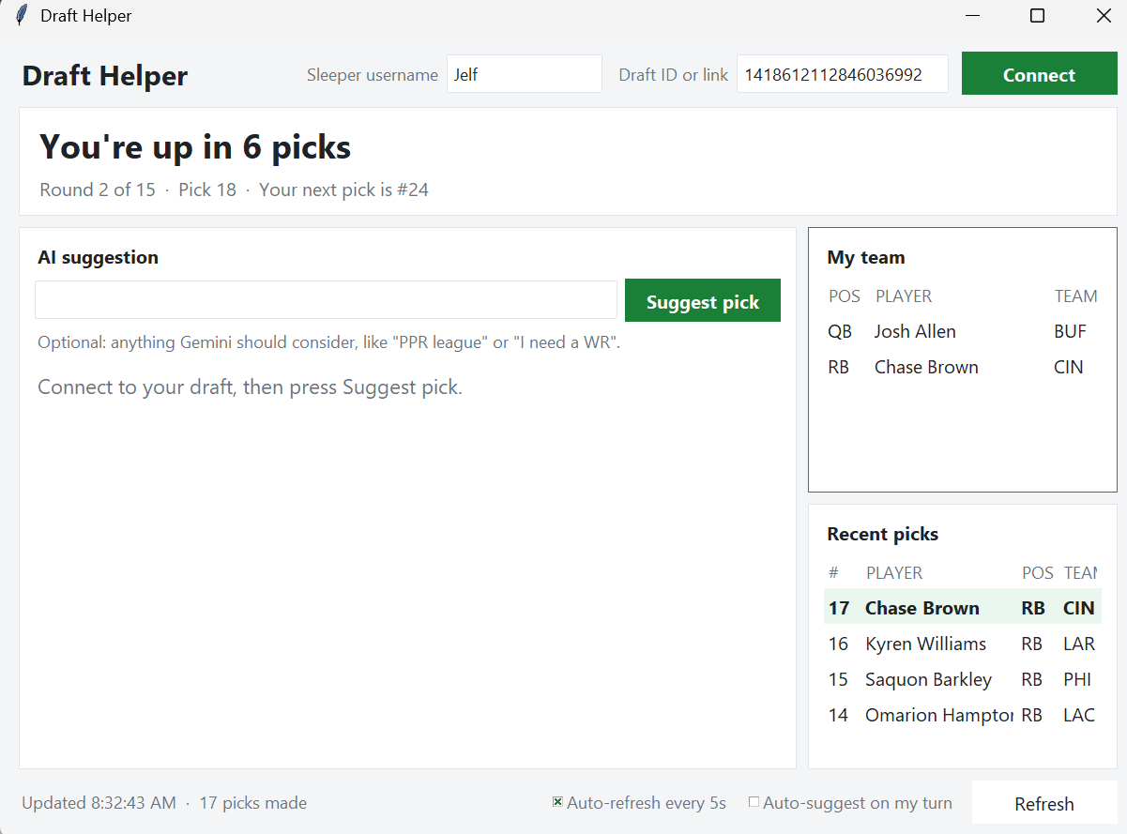
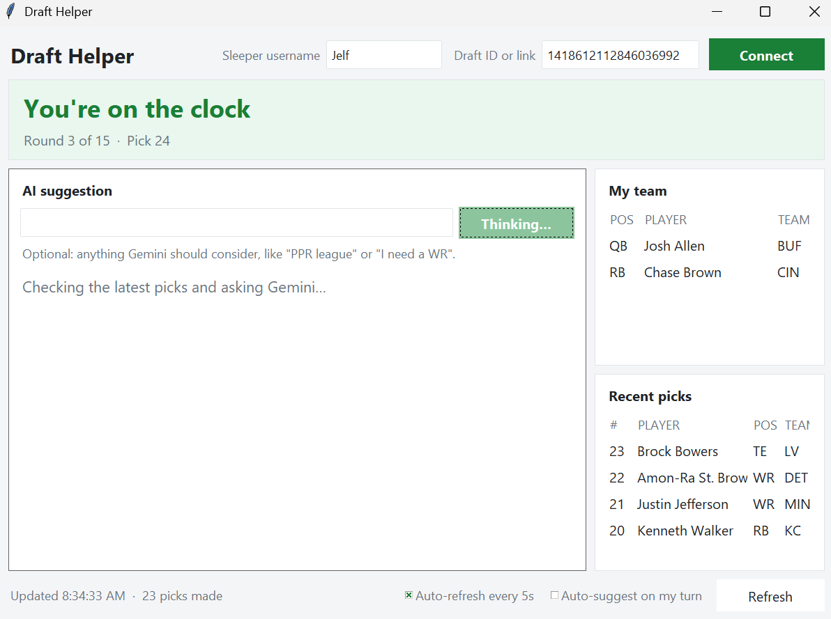
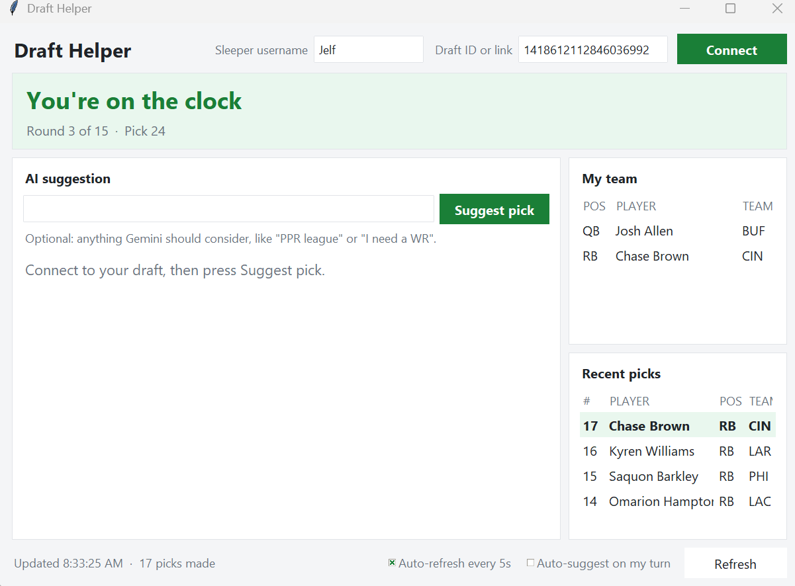
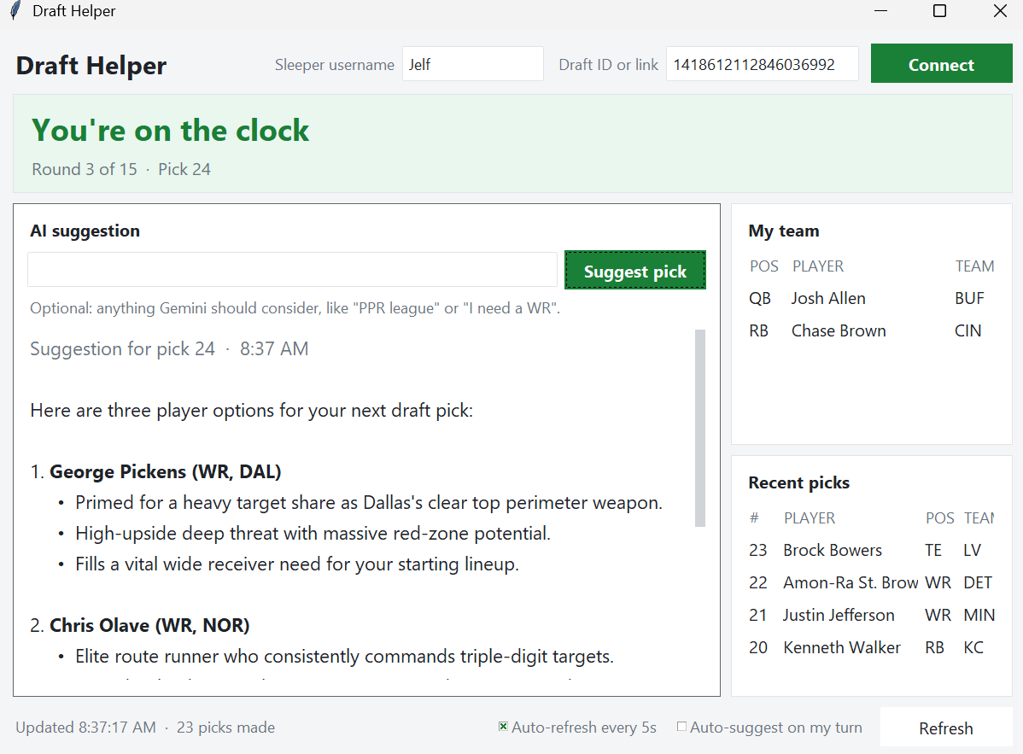
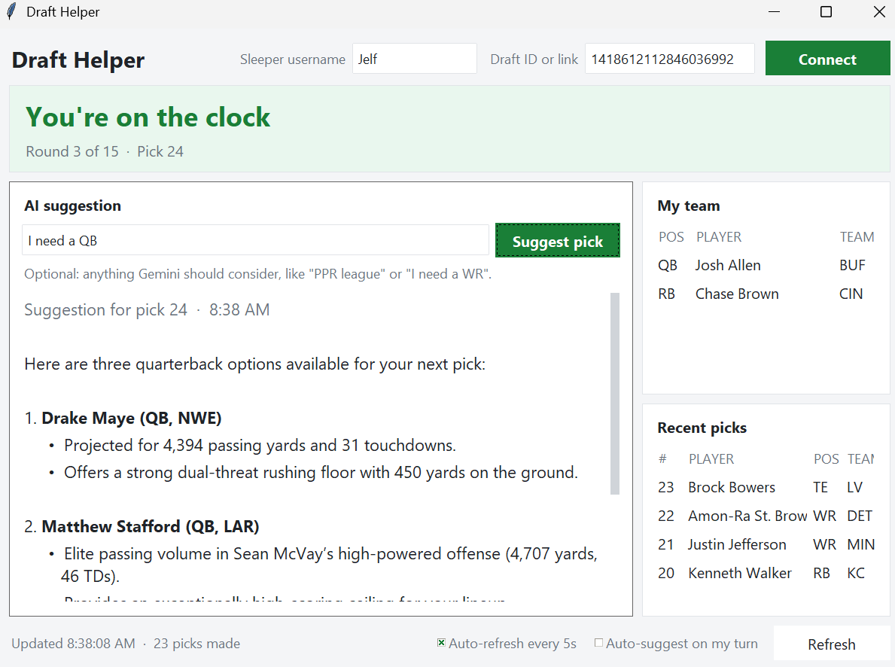

Slide 6

Future of the project/Reflections
Even though current data is fed to the agent, in a future development we would like to strengthen the RAG features.
We would like to move beyond just the draft process and implement the draft helper into week-by-week matchups.
Through the project we gained a stronger understanding in API interactions, system prompts, and prompt engineering.

